Slide 1

Thực hành
NHẬN DẠNG NGUYÊN ÂM KHÔNG PHỤ THUỘC VÀO NGƯỜI NÓI
Nhóm 6
01

Slide 2
THÀNH VIÊN
Mục 1 :Phân đoạn tín hiệu thành nguyên âm và khoảng lặng .
Mục 2a : Đánh dấu vùng có đặc trưng phổ ổn định đặc trưng cho nguyên âm .
Mục 2b: Trích xuất vecto MFCC .
Nguyễn Tri An
Mục 2c : Tính vecto đặc trưng cho 1 nguyên âm của 1 người nói .
Mục 2d : Tính vecto đặc trưng cho 1 nguyên âm của nhiều người nói .
Bùi Ngọc Thịnh
Mục 3 : Tính khoảng cách Euclid và đưa ra quyết định .
Mục nâng cao : Phương pháp phân cụm K-means .
Nguyễn Đức Nghĩa
Phạm Sỹ Hoàng
Thống kê dữ liệu và viết báo cáo .
05

Slide 3

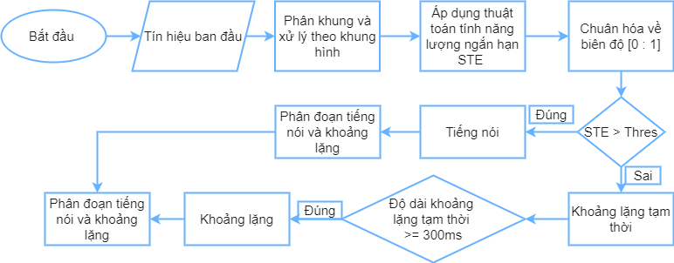
THUẬT TOÁN PHÂN ĐOẠN TIẾNG NÓI VÀ KHOẢNG LẶNG
02

Slide 4
Education
HIGHER EDUCATION
Presentations are tools that can be used as lectures.

Slide 5


Project 3
DETAILS
Presentations are tools that can be used as lectures.
DETAILS
Presentations are tools that can be used as lectures.
DETAILS
Presentations are tools that can be used as lectures.
CREATIVE PORTFOLIO
10

Slide 6

WORK EXPERIENCE 1
Presentations are tools that can be used as lectures.
WORK EXPERIENCE 2
Presentations are tools that can be used as lectures.
Work experience
WORK EXPERIENCE 3
Presentations are tools that can be used as lectures.
WORK EXPERIENCE 4
Presentations are tools that can be used as lectures.
WORK EXPERIENCE 5
04
CREATIVE PORTFOLIO
Presentations are tools that can be used as lectures.

Slide 7





Skills and abilities
Characteristic 1
Characteristic 2
Characteristic 3
Characteristic 4
CREATIVE PORTFOLIO
05

Slide 8
Skills and abilities
Characteristic 1
Characteristic 2
Characteristic 3
Characteristic 4
CREATIVE PORTFOLIO
05

Slide 9
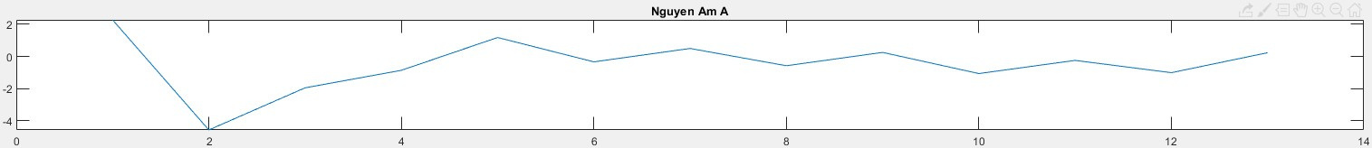

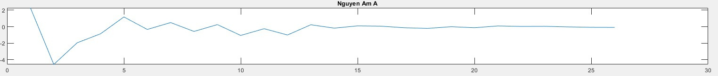
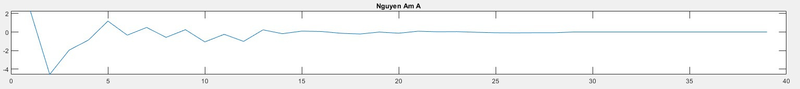
VECTOR ĐẶC TRƯNG
NGUYÊN ÂM A

Slide 10
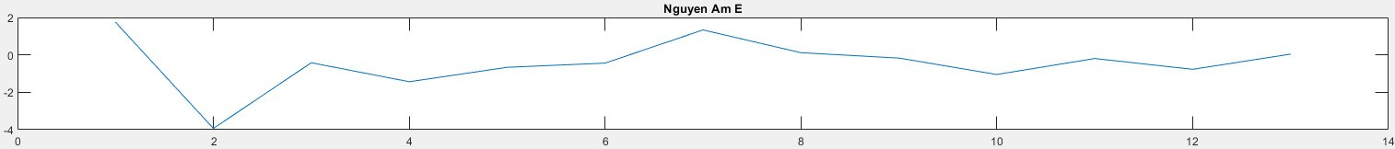
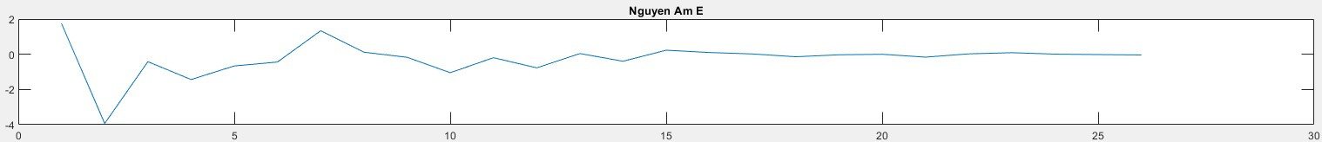
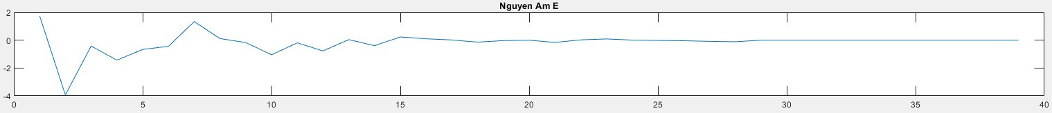
VECTOR ĐẶC TRƯNG
NGUYÊN ÂM E

Slide 11
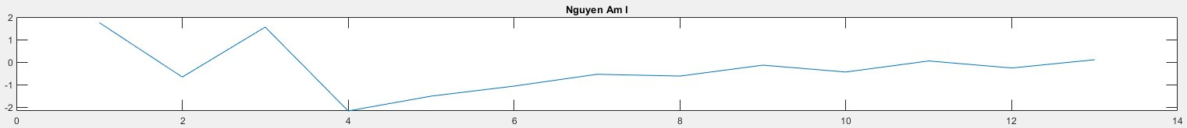
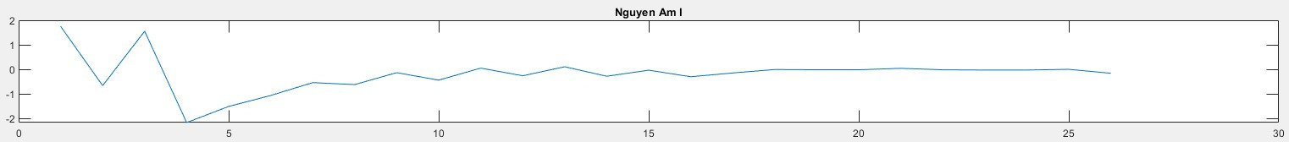
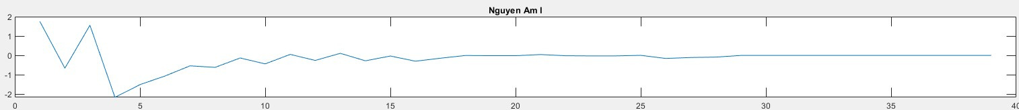
VECTOR ĐẶC TRƯNG
NGUYÊN ÂM I

Slide 12
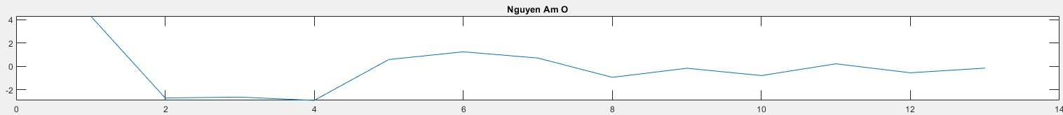
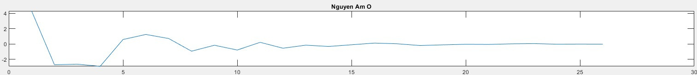
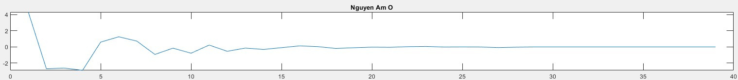
VECTOR ĐẶC TRƯNG
NGUYÊN ÂM O

Slide 13
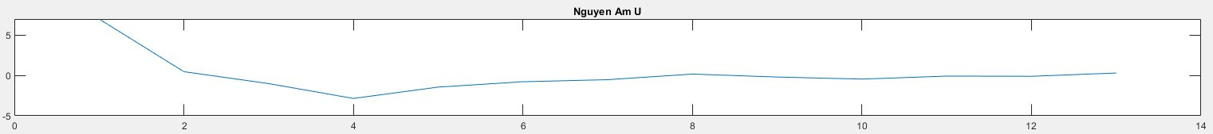
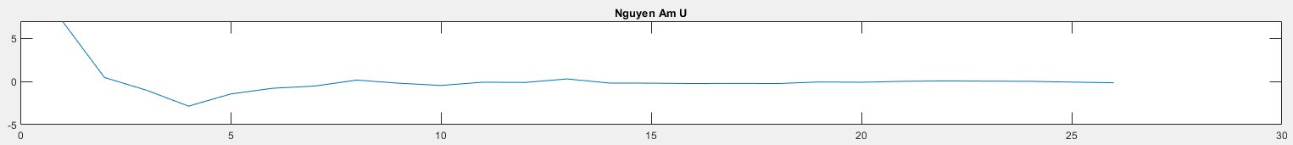
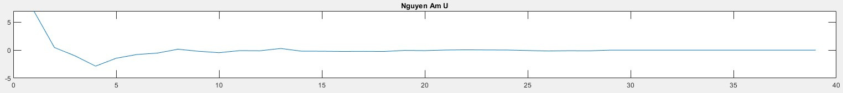
VECTOR ĐẶC TRƯNG
NGUYÊN ÂM U

Slide 14

Project 1
Presentations are communication tools that can be used as demonstrations, lectures, speeches, reports, and more.
CREATIVE PORTFOLIO
07

Slide 15

Presentations are communication tools that can be used as lectures, reports, and more.
CREATIVE PORTFOLIO
08

Slide 16

Project 2
Presentations are communication tools that can be used as demonstrations, lectures, speeches, reports, and more.
CREATIVE PORTFOLIO
09

Slide 17
Project 3
DETAILS
Presentations are tools that can be used as lectures.
DETAILS
Presentations are tools that can be used as lectures.
DETAILS
Presentations are tools that can be used as lectures.
CREATIVE PORTFOLIO
10

Slide 18

Project 4
Presentations are communication tools that can be used as demonstrations, lectures, speeches, reports, and more.
CREATIVE PORTFOLIO
11

Slide 19



PROJECT 5
Creative Portfolio
12

Slide 20
Demo reel
Presentations are communication tools that can be used as lectures.
13

Slide 21
Recommendations
Presentations are communication tools that can be used as demonstrations, lectures, speeches, reports, and more.
CREATIVE PORTFOLIO
14

Slide 22



EMAIL
hello@reallygreatsite.com
MOBILE
Let's work together
123-456-7890
MAILING ADDRESS
123 Anywhere St.,
Any City, ST 12345
15
CREATIVE PORTFOLIO

